Slide 1
Indexing
‹#›
Notes:
‹#›

Slide 2
Basic Concepts
Indexing mechanisms used to speed up access to desired data.
E.g., author catalog in library
Search Key - attribute or set of attributes used to look up records in a file.
An index file consists of records (called index entries) of the form
Index files are typically much smaller than the original file
Two basic kinds of indices:
Ordered indices: search keys are stored in sorted order
Hash indices: search keys are distributed uniformly across “buckets” using a “hash function”.
search-key
pointer
‹#›
Notes:
‹#›

Slide 3
Index Evaluation Metrics
Access types supported efficiently. E.g.,
records with a specified value in the attribute
or records with an attribute value falling in a specified range of values.
Access time
Insertion time
Deletion time
Space overhead
‹#›
Notes:
‹#›

Slide 4
Ordered Indices
In an ordered index, index entries are stored sorted on the search key value. E.g., author catalog in library.
Primary index: in a sequentially ordered file, the index whose search key specifies the sequential order of the file.
Also called clustering index
The search key of a primary index is usually but not necessarily the primary key.
Secondary index: an index whose search key specifies an order different from the sequential order of the file. Also called non-clustering index.
Index-sequential file: ordered sequential file with a primary index.
‹#›
Notes:
‹#›

Slide 5
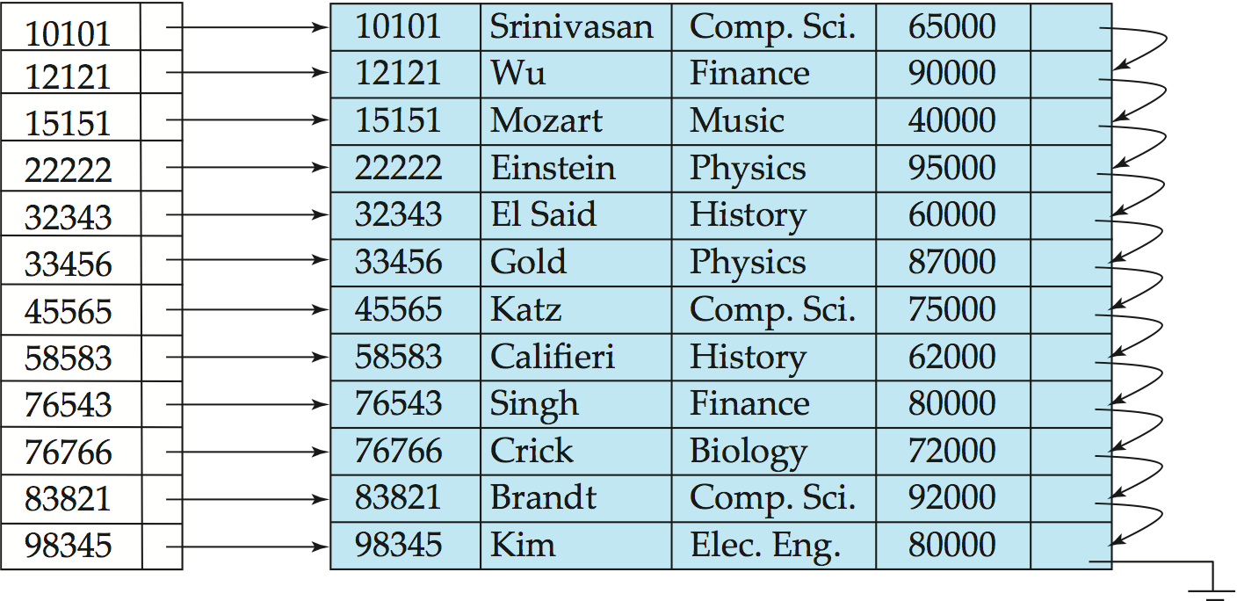
Dense Index Files
Dense index — Index record appears for every search-key value in the file.
E.g. index on ID attribute of instructor relation
‹#›
Notes:
‹#›

Slide 6
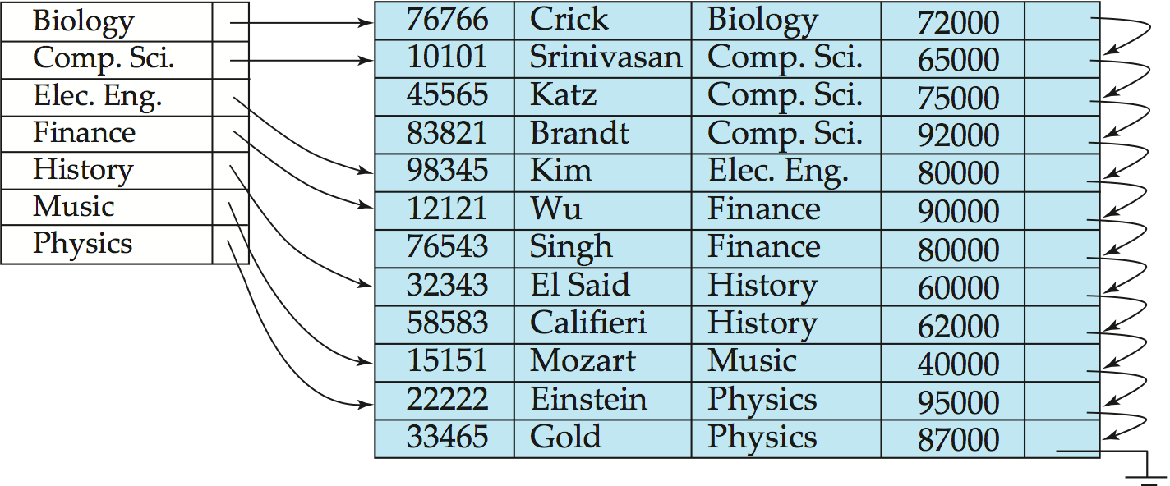
Dense Index Files (Cont.)
Dense index on dept_name, with instructor file sorted on dept_name
‹#›
Notes:
‹#›

Slide 7
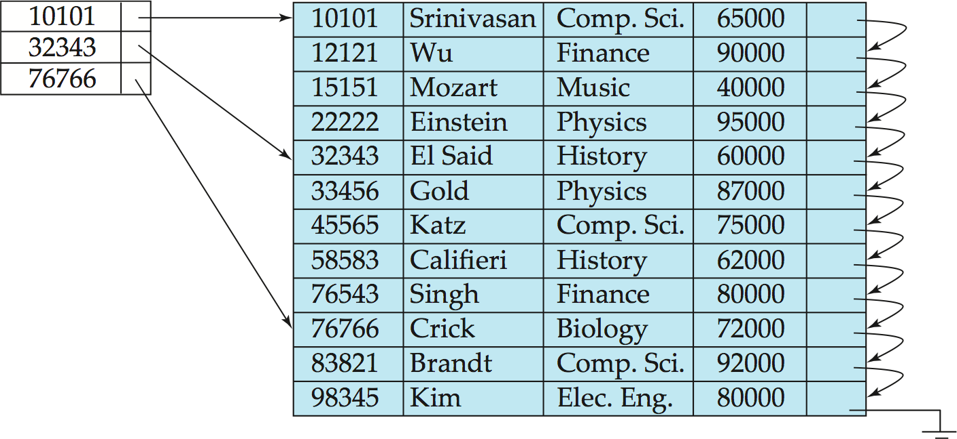
Sparse Index Files
Sparse Index: contains index records for only some search-key values.
Applicable when records are sequentially ordered on search-key
To locate a record with search-key value K we:
Find index record with largest search-key value < K
Search file sequentially starting at the record to which the index record points
‹#›
Notes:
‹#›

Slide 8
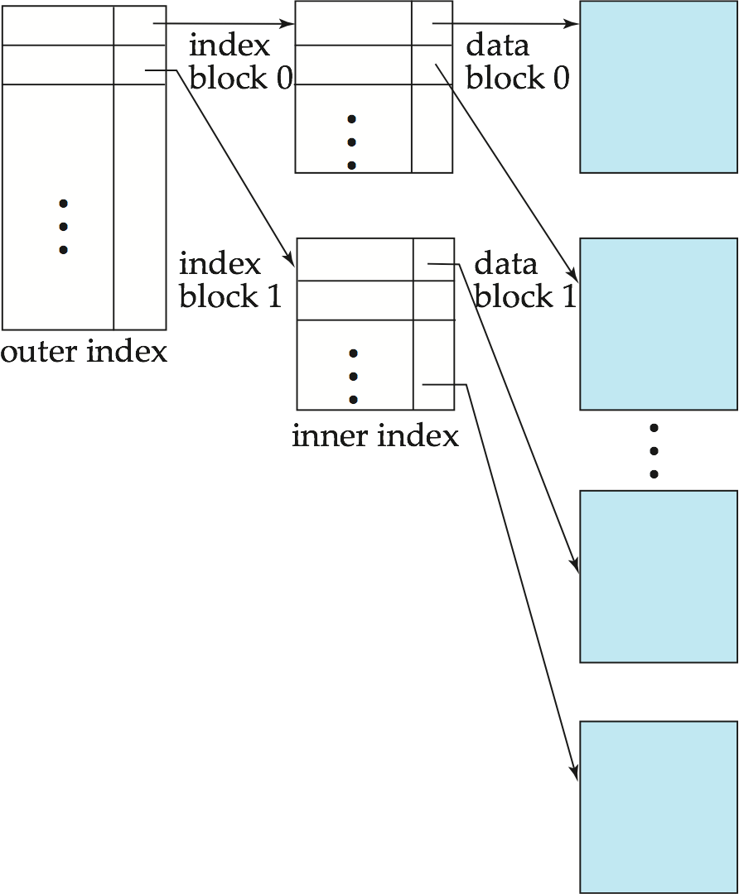
Sparse Index Files (Cont.)
Compared to dense indices: (CT-4)
(a) Less space and less maintenance overhead for insertions and deletions (How?).
(b) Generally slower than dense index for locating records (How?).
Good tradeoff: sparse index with an index entry for every block in file, corresponding to least search-key value in the block.
‹#›
Notes:
‹#›

Slide 9
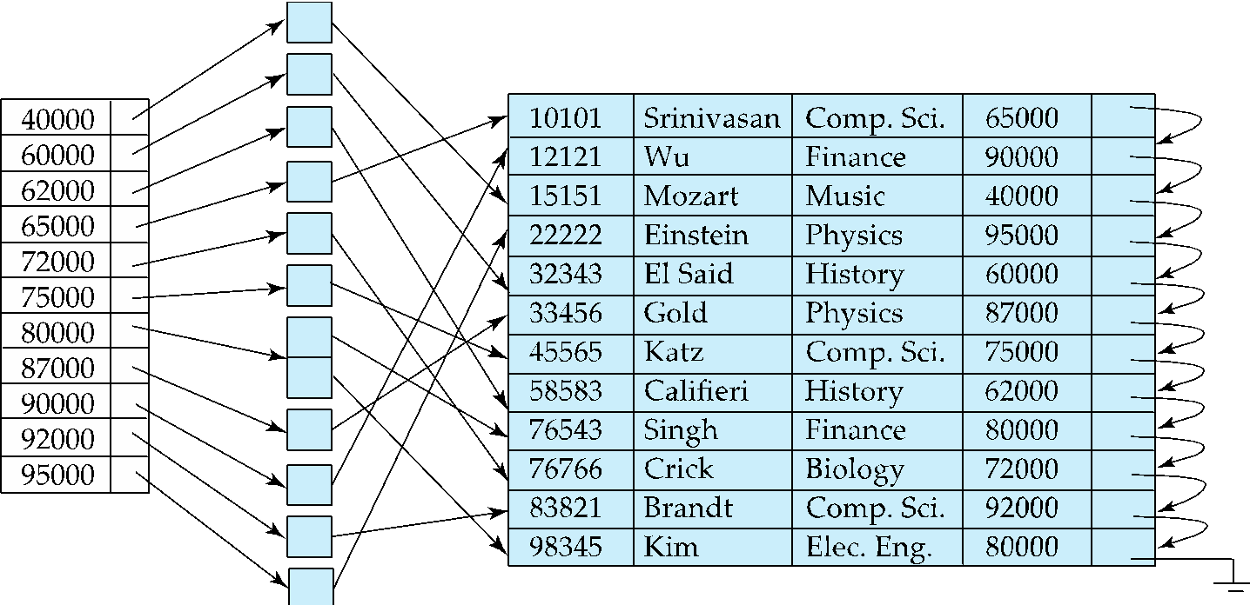
Secondary Indices Example
Secondary index on salary field of instructor
Index record points to a bucket that contains pointers to all the actual records with that particular search-key value.
Secondary indices have to be dense
‹#›
Notes:
‹#›

Slide 10
Secondary Indices Example
Secondary index on salary field of instructor
CT-4
c. Find the query cost for SELECT * FORM instructor WHERE salary = 72000
d. Find the query cost for SELECT * FORM instructor WHERE salary >= 72000
‹#›
Notes:
‹#›

Slide 11
Primary and Secondary Indices
Indices offer substantial benefits when searching for records.
BUT: Updating indices imposes overhead on database modification --when a file is modified, every index on the file must be updated,
Sequential scan using primary index is efficient, but a sequential scan using a secondary index is expensive
Each record access may fetch a new block from disk
Block fetch requires about 5 to 10 milliseconds, versus about 100 nanoseconds for memory access
‹#›
Notes:
‹#›

Slide 12
Multilevel Index
If primary index does not fit in memory, access becomes expensive.
Solution: treat primary index kept on disk as a sequential file and construct a sparse index on it.
outer index – a sparse index of primary index
inner index – the primary index file
If even outer index is too large to fit in main memory, yet another level of index can be created, and so on.
Indices at all levels must be updated on insertion or deletion from the file.
‹#›
Notes:
‹#›

Slide 13
Multilevel Index (Cont.)
‹#›
Notes:
‹#›

Slide 14
Index Update: Deletion
If deleted record was the only record in the file with its particular search-key value, the search-key is deleted from the index also.
Single-level index entry deletion:
Dense indices – deletion of search-key is similar to file record deletion.
Sparse indices –
if an entry for the search key exists in the index, it is deleted by replacing the entry in the index with the next search-key value in the file (in search-key order).
If the next search-key value already has an index entry, the entry is deleted instead of being replaced.
‹#›
Notes:
‹#›

Slide 15
Index Update: Insertion
Single-level index insertion:
Perform a lookup using the search-key value appearing in the record to be inserted.
Dense indices – if the search-key value does not appear in the index, insert it.
Sparse indices – if index stores an entry for each block of the file, no change needs to be made to the index unless a new block is created.
If a new block is created, the first search-key value appearing in the new block is inserted into the index.
Multilevel insertion and deletion: algorithms are simple extensions of the single-level algorithms
‹#›
Notes:
‹#›

